Slide 1
Potential use of multiplex serological assays in DHS surveys
Heather Scobie
Epidemiologist, VPD Surveillance Team
Accelerated Disease Control and VPD Surveillance Branch
Global Immunization Division, CDC
Technical Consultation on Vaccination Data in Household Surveys
ICF International, July 24, 2015
Center for Global Health
Global Immunization Division

Slide 2
background

Slide 3
Vaccination coverage survey vs. serosurvey
Vaccination coverage survey ≈ population that received vaccine dose(s)
Serosurvey ≈ population immunity
When representative of population, both:
Monitor immunization program performance if repeated at regular intervals
Provide complementary information useful to the program

Slide 4
Pros and cons of vaccination coverage surveys vs. serosurveys
 | Vaccination Coverage | Serology
Pros | Relatively low cost Discern RI vs. SIA doses Identify missed opportunities | Objective biological measure Better marker of disease risk Useful for older children and adults (history unreliable)
Cons | Recall bias (unless high rate of documentation) Can’t measure disease immunity | Can’t discern vaccination vs. natural infection (most diseases) Can’t measure cell mediated immune response Requires high technical capacity Relatively high cost

Slide 5
Use of representative serosurvey data
Gold standard for estimating immunity and disease risk (e.g., immunity gaps, antibody levels)
Vaccination coverage often used to approximate immunity because serosurveillance not available
Used to guide policy and strategy, from vaccine introduction to verification of disease elimination
Repeated serosurveys document changing epidemiology resulting from accelerated VPD control efforts
Increasingly desired/required as evidence for progress towards elimination goals (e.g., polio, measles, rubella, tetanus, hepatitis B)

Slide 6
Traditional methods for serological testing in surveys
Binding assays — enzyme-linked immunosorbent assay (ELISAs), immunofluorescent assay (IFAs)
Many ELISAs commercially available
Functional assays — neutralization, bactericidal activity, agglutination
Strengths — gold-standards, widely used, high-throughput options exist or in development
Weaknesses — separate assays for each antigen, serum volume limited, labor intense
Developing country setting — repeated national serosurveys for individual pathogens not logistically or financially viable

Slide 7
Multiplex methods for serological testing in surveys
Multiplex — multiple antigens, same sample, same time
ELISAs (e.g., Dynex™), fluorescence-based assays (e.g., Luminex®)
Single tool for measurement of impact across programs
VPDs, malaria, NTDs, vector-borne, water and food-borne diseases
Increasingly used by national programs for integrated serosurveillance (e.g., Netherlands, U.K.)
Strong economic rationale — more useful data for less $
Notes:
Integrated serosurveillance, rather than individual technology

Slide 8
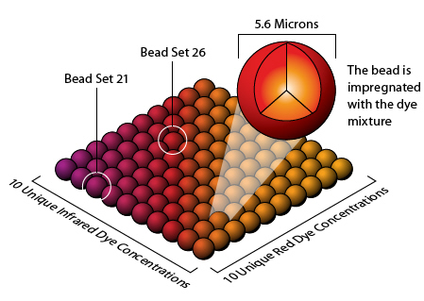
Luminex®-based multiplex bead assay (MBA) (1)
Beads with 2 dyes mixed in different ratios — 100 possible bead types
Specific bead type chemically cross-link antigen of interest
Protein or carbohydrate — require free primary amine

Slide 9
Luminex®-based MBA (2)
Bead
Serum IgG
Antigen
Biotinylated mouse anti-human IgG
Steptavidin-labeled phycoerythrin
(PE) reporter
96-well filter plate
Single sample dilution (or two), in duplicate
Up to 100 antigen-specific beads per well
Notes:
9

Slide 10
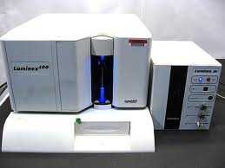
Luminex®-based MBA (3)
Flow cytometric detection with Luminex® machine
Red laser — type of bead/antigen
Green laser — amount of antibody bound
Readout in median fluorescence intensity (MFI)
Quantification by interpolation to standard curve (convert to IU/ml)

Slide 11
Technical features of MBA
Strengths
Multiple, simultaneous assays possible
Low sample volume requirements (1µl per MBA)
Reduced materials and labor costs from multiplexing
High reproducibility and correlation with traditional methods
Good dynamic range
Weaknesses
Maintenance of machine
Need to validate each antigen
Not all assays have recognized cutoffs

Slide 12
CDC experience with MBA
Assay validation and serosurveys — since 2011
VPDs, malaria, NTDs, vector-borne, water and food-borne diseases
Technology transfer (20–25 antigens) to regional labs
Kenya (KEMRI), 2014
Haiti (national lab), 2016
Collaboration with WHO and Netherlands (RIVM)
Measles and rubella (MR) MBA standardization and tech transfer to regional labs in WHO Global MR Laboratory Network
Future — hope to establish CDC service laboratory

Slide 13
Example of MBA USE in a serosurvey

Slide 14
Cambodia tetanus serosurvey, 2012
National multi-stage cluster survey among 2,154 women aged 15–39 years
Firsts for tetanus MBA
Evaluation relative to gold-standard, Double Antigen ELISA (DAE), at SSI, Denmark
Use in a national serosurvey in a developing country setting
Integrated disease testing — ELISA (measles, rubella), neutralization (polio), MBA for 18 other antigens
Viral — measles, rubella, dengue, chikungunya, West Nile, Japanese encephalitis, yellow fever
Parasitic — malaria (P. vivax, P. falciparum), Lymphatic fillariasis (LF), cysticercosis, Toxoplasma gondii, Strongyloides stercoralis

Slide 15
Concordance of tetanus serological results by MBA vs. gold-standard DAE
 |  | No. specimens by DAE result |  |  | Total for MBA
 |  | + | –
No. specimens by MBA result | + | 1843 | 23 |  | 1866
 | – | 19 | 265 |  | 284
Total for DAE |  | 1862 | 288 |  | 2150
Sensitivity: 99% (95% CI: 98–99%)
Specificity: 92% (95% CI: 88–95%)
Performed better than commercial ELISAs that overestimate antibody levels in low seroprotective range (≥0.01 to <0.2 IU/ml)

Slide 16
Tetanus seroprotection of women aged 15–39 years, by test, Cambodia
 | Seroprotected (total no. 2,150)
Test | No. | % | LCL | UCL
DAE (gold standard) | 1,862 | 88 | 86 | 89
MBA | 1,866 | 87 | 85 | 89

Slide 17
Tetanus immunity gaps among women aged 15–39 years, by test, Cambodia
 |  |  | % seroprotected
Population |  |  | DAE |  | MBA
Region |  | Phnom Penh | 87 |  | 87
 |  | Southeast | 90 |  | 89
 |  | Southwest | 88 |  | 89
 |  | West | 82* |  | 81*
 |  | North | 91 |  | 90
Age (years) |  | 15-19 | 63* |  | 63*
 |  | 20-24 | 87* |  | 85*
 |  | 25-29 | 95 |  | 96
 |  | 30-34 | 96 |  | 97
 |  | 35-39 | 96 |  | 96
Parity |  | Parous | 97 |  | 97
 |  | Nulliparous | 71* |  | 71*
* Statistically significant relative to other sub-populations

Slide 18
Levels of tetanus antibodies among women aged 15–39 years, Cambodia
Long-term
protection
Seroprotection
No protection
Age (years)

Slide 19
Under-reporting of TT doses received among nulliparous women aged 15–39 years, Cambodia
Pregnant women receive 5 TT doses during antenatal care visits
WCBA in high-risk districts receive 3 TT campaign doses (2000–2011)
Women aged ≤24 years would have received infant 3 DTP doses
In survey, 42% card availability, campaign doses not documented
Notes:
This is a comparison of seroprotection to the number of tetanus doses that were reported to have been received among nulliparous women.
You can see increasing sero-protection with increasing numbers of doses reported, which is reassuring. But, there are higher levels of seroprotection than would be expected for women who had received zero doses, or one dose, which would be a priming rather than protective dose. As part of the MNTE program, pregnant women receive 5 tetanus doses during antenatal care visits, and women of child-bearing age receive 3 tetanus doses during campaigns in high risk districts, which occurred in Cambodia during 2000-2011. Increasing numbers of adult women have also been vaccinated against tetanus as infants. Infant doses can’t be accounted for in surveys of adult women, but may have provided some residual immunity for some women. Others may have forgotten receiving campaign doses. In this survey, card availability was low and campaign doses weren’t documented.

Slide 20
Public health impact from integrated disease testing in Cambodia serosurvey
Tetanus immunity (88%) relevant for 2015 Maternal and Neonatal Tetanus Elimination (MNTE) validation
Measles immunity (96%) supported 2015 verification of measles elimination
Congenital rubella syndrome (CRS) incidence model — rationalization for 2013 rubella vaccine introduction
LF incidence localized to area targeted by MDA
Malaria prevalence (5% vivax, 5% falciparum) higher than estimated by microscopy
High (>40%) national prevalence of Strongyloides

Slide 21
Technical and logistical considerations for mba use

Slide 22
MBA validation and standardization
Various antigens validated in different labs world-wide (e.g., Netherlands, U.K.)
Test not commercially available, not “WHO-approved”
Potential for variability
Preparation of antigen and chemical coupling to beads
Degradation of beads over time (shelf-life: 3–12 months)
Standardization
Antigen preparation (can use commercially prepared)
Use same preparation of beads for entire survey
WHO standard reference sera to create standard curve
Internal control sera run on each plate
SOPs — assays and analysis

Slide 23
Current MBA Panels at CDC
Vaccine preventable diseases
Measles, tetanus, rubella, diphtheria
Waterborne/foodborne diseases
Cryptosporidium, Giardia, Toxoplasma, Salmonella LPS Group B and D, norovirus, E. histolytica, Campylobacter, ETEC/ cholera
Neglected tropical diseases/ vectorborne
Filariasis, Strongyloides, Babesia microti, trachoma, Plasmodium falciparum, cysticercosis, Onchocerca, Schistosoma mansoni, dengue, Rift Valley Fever Virus, Yaws, Ascaris, Chikungunya virus, other Plasmodium spp.
Planned
Leptospirosis, pertussis, hepatitis B virus
For those highlighted in orange, we have defined serum panels and have determined the sensitivities and specificities of the assays. For those in white, full characterization is incomplete, but coupled antigens are capable of binding antibodies.

Slide 24
MBA sensitivity and specificity for VPD antigens, CDC*
Antigen | Compared to gold standard | Serum source | Sensitivity (95% CI) | Specificity (95% CI)
Tetanus | DAE (SSI, Denmark) | Cambodia WCBA | 99% (98–99%) | 92% (88–95%)
Measles | Enzygnost anti-measles IgG ELISA (Siemens, Germany) | Tajikistan multiple age-strata | 94% (93%–96%) | 90% (84%–94%)
Rubella | Enzygnost anti-rubella IgG ELISA (Siemens, Germany) | Cambodia WCBA | 97% (95–98%) | 94% (91–97%)
Diphtheria | Vero cell neutralization assay (PHE, UK) | Tajikistan multiple age-strata | Currently optimizing
* Not published, tetanus manuscript in clearance

Slide 25
Other VPD antigens currently in use with MBA by other labs
Pertussis
Hepatitis B
Meningococci type C (A, W, Y)
Hib
Pneumococci (13 serotypes)
Mumps
HPV (7 serotypes)
Influenza A and B
Varicella
Hepatitis A
** Polio — not possible

Slide 26
Blood specimen collection for MBA
Venipuncture — collect 5 ml in tube (1 ml for infant)
Finger prick — collect 10 µl on filter paper
Enough for ~10 MBA repeats (each up to 100 antigens)
Less volume (1/10th) than required for ELISA
Can be collected at same time as HemoCue test?

Slide 27
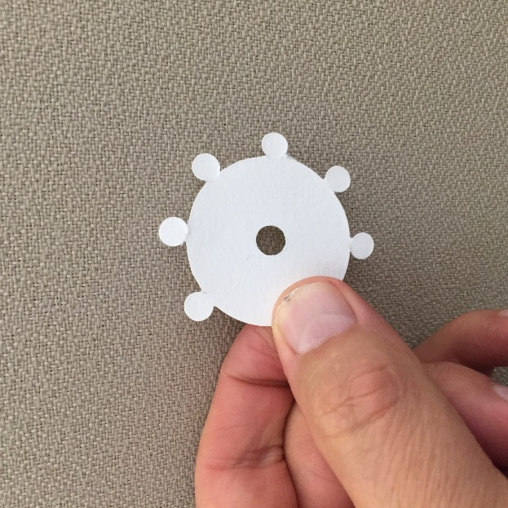
Using round filter papers
Commercially available
Each small circle collects 10 µl blood
Easy to use in field (easy drying) and lab
Prevents cross-contamination from sequential punching of filters without proper washing

Slide 28
MBA startup, equipment and maintenance costs
Startup costs $100,000–$150,000
Includes machine and training
Capital equipment and maintenance > ELISA
ELISA
$16,000
0
MBA
$60,000
$7,400/yr
Capital Equipment
Maintenance*
* Maintenance higher outside the U.S.

Slide 29
Estimated Operating Costs
Breakpoint for MBA cost savings over ELISA — as low as 2 antigens
Recent measles and rubella serosurveys
ELISA at local lab — $20 per sample ($10/ELISA)
MBA at CDC — $15 per sample (for 2 antigens)
If performed locally, labor cheaper, maintenance higher
Low incremental cost to add antigens ($0.25-$0.50)
Add tetanus for $0.25/sample vs. $30/sample for DAE
MBA 20-plex — $20 total per sample
Testing 5,000 samples in MBA 20-plex ≈ $100,000

Slide 30
Requirements for running Luminex®
Continuous, reliable power supply — important
Running water
Temperature controlled room
Refrigerator and freezer
Dedicated computer

Slide 31
MBA technical capacity
Training — if can run ELISA, can run multiplex
Bead coupling — not done in-country
Output — 80 samples/workday (2 technicians= 160 samples/10+ hour workday)
5,000 samples ≈ 3+ months for 1 technician, or 6 weeks for
2 technicians

Slide 32
Considerations for MBA use in DHS
Start-up costs not prohibitively expensive relative to other technologies
Many countries have machines not currently in use
Instrument maintenance — international technician ($$)
Regional strategy — ensure continuous machine use, technical capacity, quality (or repeat every ~5 years)
Collaboration with experienced lab partners required
Country labs can’t do bead coupling
Assistance with training, standardization
Antigens and target ages to be determined based on country needs and disease epidemiology

Slide 33
Summary
Serosurvey data
provide information on population immunity that is complementary to vaccination coverage survey data
may be used to guide policy/strategy, from vaccine introduction to verification of disease elimination
MBAs provide useful data across multiple programs at a cost savings compared to individual testing
Integration of serosurveys into periodic national health surveys may be feasible with MBA testing

Slide 34
"The findings and conclusions in this presentation have not been formally disseminated by CDC and should not be construed to represent any agency determination or policy."

Slide 35
Acknowledgements
Division of Foodborne, Waterborne and Environmental Diseases
Delynn Moss
Jeff Priest
Global Immunization Division
Kathleen Wannemuehler
Christopher Gregory
Ben Dahl
Minal Patel
Katrina Kretsinger
Jim Goodson
Sue Reef
Jim Alexander
Division of Parasitic Diseases and Malaria
Patrick Lammie
Kim Won
Brook Goodhew
Katy Hamlin
Harley Jenks
Michael Deming
Diana Martin
Evan Secor
Division of Viral Diseases
Bill Bellini
Paul Rota
Joe Icenogle
Melissa Coughlin
Some projects funded by the Bill and Melinda Gates Foundation

Slide 36
Thank you!
For more information please contact Centers for Disease Control and Prevention
1600 Clifton Road NE, Atlanta, GA 30333
Telephone: 1-800-CDC-INFO (232-4636)/TTY: 1-888-232-6348
E-mail: cdcinfo@cdc.gov Web: http://www.cdc.gov
The findings and conclusions in this report are those of the authors and do not necessarily represent the official position of the Centers for Disease Control and Prevention.
Center for Global Health
Global Immunization Division

Slide 37
Supplementary slides

Slide 38
Comparison of Cambodia tetanus coverage survey and serosurvey data
Cambodia data | Indicator | Population
DHS 2010 | PAB*: 85% | Women with live birth in 5 years preceding survey
DHS 2014 | PAB*: 89% | “
Serosurvey 2012 | Seroprotection: 88% | Women aged 15-39 years
“ | Seroprotection: 97% | Parous women aged 15-39 years
*PAB defined as receiving 2 TT doses during the pregnancy of the last birth; or ≥2 TT doses with the last dose ≤3 years prior to last birth; or ≥3 doses with the last dose ≤5 years prior; or ≥4 doses with the last dose ≤10 years prior; or ≥5 prior doses

Slide 39
Comparison of tetanus coverage and seroprotection from other national serosurveys
Country/year | PAB* | Seroprotection | Population
Burundi 1989 | 73% | 67% | Women giving birth in past year
CAR 1996 | 76% | 89% | “
“The accuracy of TT coverage estimates may vary between countries according to the proportion of TT doses given several years in the past (including those given as part of DPT vaccinations in infancy), whether TT is given outside of antenatal visits, and the availability of cards (if information from cards is used to determine TT vaccination status).” ---Deming et al.
World Health Organization. Wkly Epidemiol Rec 1996; 71:117-24
Deming et al. Bull World Health Organization 2002; 80:696-703.

Slide 40
Considerations for use of biomarkers to classify vaccination history
Vaccine effectiveness (e.g. measles 85% at 9 months)
Type of vaccine and duration of immunity
Live-attenuated — long immunity
Non-replicative — shorter immunity, multiple doses required
Interval since vaccination (waning immunity)
Limited ability to discriminate receipt of multiple doses
Or RI vs. SIA doses
Likelihood of exposure to natural infection
Not relevant for tetanus
Can discern hepatitis B infection from vaccination with HBsAg
Misclassification error (sensitivity, specificity, PVP, PVN)

Slide 41
Considerations for target age groups for serosurveys
Children <5 years
Group birth cohorts by dose eligibility (e.g. measles)
Best measure of recent RI vaccination (before waning immunity)
Target of follow-up SIAs
Older children
Immunity gaps from suboptimal coverage — role in transmission in advanced elimination settings
Waning immunity (e.g. DTP)
Target of wide-age range (<15 years) MR SIAs
Adults
WCBA of interest for rubella (risk of CRS) and tetanus (MNTE)
Increasingly vaccinated as infants, but no documentation
Suboptimal coverage, waning immunity, natural infection

