Slide 1
Vaccination data collection from health facilities: Albania

Slide 2
Albania DHS 2008-09
Conducted by
National Institute of Statistics (INSTAT)
Institute of Public Health (IShP)
Part of the Ministry of Health
Fieldwork teams visited each enumeration area
Point of contact in EA was the health center workers

Slide 3
Health care system in Albania
Mixture of public and private
Primary care centers – baby clinics, health posts (fixed post sites and outreach activities)
Outreach activities – community participation
Private sector – primary and secondary care
Private sector
Mostly private doctors in urban areas
Same national standards and vaccination schedule apply
Same registration requirements
Required to provide information to public health system when needed
Urban areas - typically 1 (or 2) public health posts, possibly 1 (or 2) private doctors
Rural areas - typically only one health post

Slide 4
Data collection
Home-based records:
Child health booklet (newer)
Vaccination card (older)
Mother’s recall
Health facility records

Slide 5
Form for recording vaccination data from health facility

Slide 6
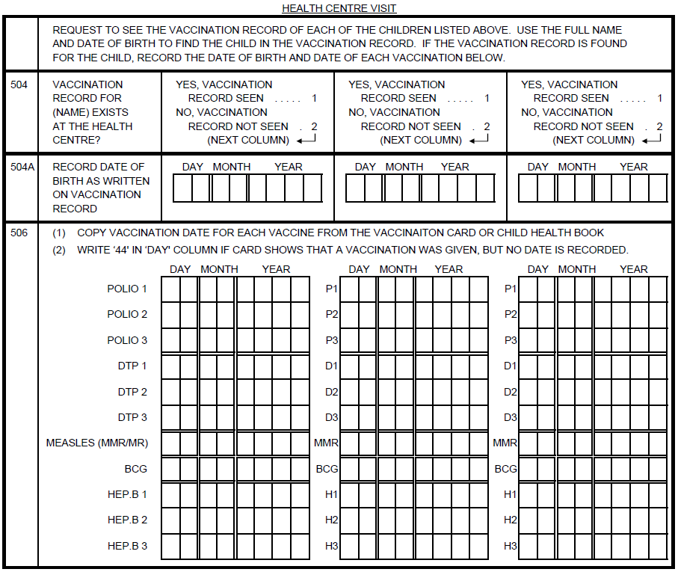

Slide 7
Health facility records
Organized in paper registers by
Date of birth
First, father’s and last name
Register has one column for each type of vaccine
recording vaccination date
Data collection
Team supervisor collected forms for each child from interviewers after household interview
With help of health center worker, found each eligible child in the register
Recorded dates of vaccination for each eligible child

Slide 8
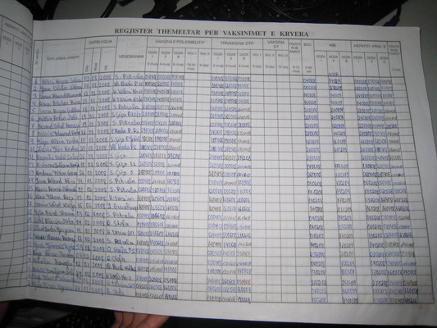
Names
DoB
Polio
DTP
BCG
Hib
HepB

Slide 10
Results
Home based record: | No health facility record | Health facility record found | Total children under 5
Never had a card or booklet | 6 | 113 (95%) | 119
Vaccination card seen | 12 | 815 (99%) | 827
Child health booklet seen | 0 | 206 (100%) | 206
Either exists but not seen | 23 | 250 (92%) | 273
No longer has card or booklet | 20 | 141 (88%) | 161
Total children under 5 | 61 | 1525 (96%) | 1586

Slide 11
Results
Based on the union of
Health facility record
Vaccination card or child health booklet
Mother’s recall
If vaccination was recorded in any of these ways it was accepted
When dates conflicted, priority was given to the health facility record

Slide 12
Results – DPT3 (children 12-23 months)
Interview: | Not recorded in health facility register* | Recorded in health facility register | Total children under 5
Not given | 2 | 30 | 32
Vaccination date recorded on card | 3 | 174 | 177
Vaccination marked on card (no date) | 0 | 3 | 3
Reported by mother | 6 | 46 | 52
Mother did not know | 0 | 1 | 1
Total | 10 | 254 | 265
* No vaccination record found in health facility, except 1 with no DPT3 on record

Slide 13
Key elements
Ministry of Health involved in the survey
Health center workers were point of contact in EA for interviewing teams
Vaccination records in easily accessible register
MoH required staff to give access to vaccination register
Information ordered logically by date of birth (DoB)
Identifying information needed was DoB, first, father’s and last name.
All vaccination data recorded in a single line in the register

