Slide 1
New vaccines, schedules, and target groups

Slide 2
Old schedule
1 dose of BCG
3 doses of DPT
3 doses of Oral Polio
1 dose of Measles

Slide 3
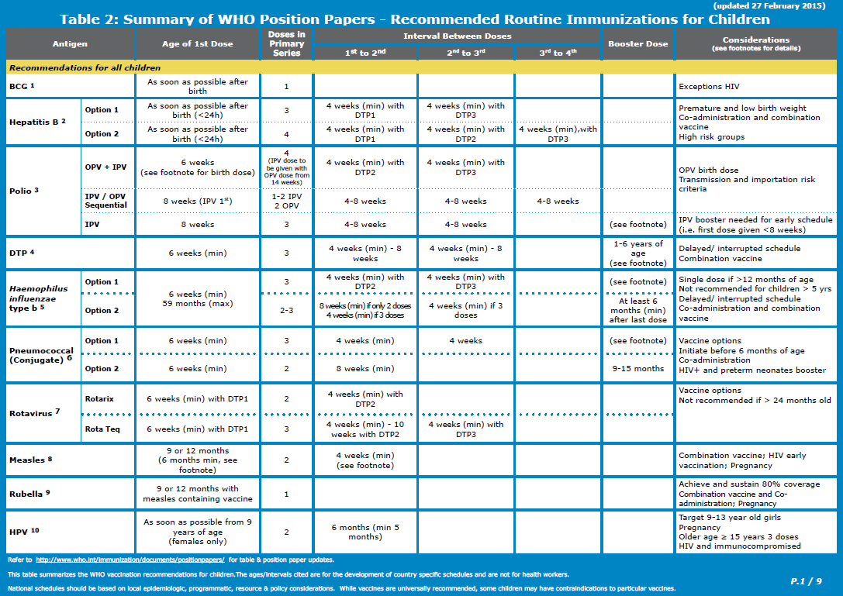
Current schedule

Slide 4
Different combinations
DPT, Hep.B, and HiB
Still separate in some countries
Increasingly as Pentavalent
Pentavalent
Occasionally different combinations (particularly with private sector health facilities – e.g. Gabon)
Measles
Sometimes with Rubella (MR) and Mumps (MMR)
Polio – OPV + IPV
Pneumococcal
3p+0
2p+1
Rotavirus
2 dose (with DPT/Penta 1 and 2) - Rotarix
3 dose (with DPT/Penta 1, 2, 3) - Rota Teq
To come?
Hexavalent (includes IPV). Others?

Slide 5
Mixed schedules
Changes in combinations of vaccines
Changes in vaccine schedules
Delayed revision of immunization cards
Questionnaire needs to handle all possible combinations in use the 3 years preceding the survey
If changes have occurred data collection and reporting can be very complicated.
Vaccinations given outside of the government health system also need to be handled
Private facilities
Given outside of the country (e.g. children in Lesotho may be vaccinated in South Africa)

Slide 6
Issues with including newer vaccines
Load on interviewers and respondents
Ability of respondents to provide all of the information needed
Multiple cards used
Cards not current with the national schedule
Revision of cards happens later than introduction of newer vaccines
Mother’s recognizing the different types of vaccination
How can a mother tell the difference between
DPT, single dose HepB, Rotavirus, Pneumococcal?
How do we expect them to remember?
It is already difficult and its going to get worse with more antigens
Need for good descriptions of individual vaccines

Slide 7
Different target groups
Indicators for children 12-23.
Data collected for children under age of 3.
MCV1 may be given at 12 or 15 months.
MCV2 at 18-24 months (or possibly later).
HPV at age 9-13 years
More later

Slide 8
Newer strategies
Fixed sites
Outreach
Mobile teams
Campaigns
Child health days
Schools
Each may have their own vaccination card or HBR
Monitoring all sources, or only routine?

Slide 9
Human Papillomavirus (HPV)
HPV
Given to girls (and boys) age 9-13 yrs
3 doses
Possible approaches:
Module for 10-14 year olds?
Monitor for girls 15-19 as part of the women’s questionnaire
Only other vaccine typically for this age is tetanus
Indicator: 15 yr olds vaccinated with HPV1, HPV2, HPV3 by age 15
Sample size issue?
Probably need to combine age groups, e.g. 15-16 yrs

Slide 10
New technologies for data collection
Scanning cards?
No software found that can scan and capture dates from cards
Photographing cards?
Captured image, but still need data entry of data on card
Perhaps only used for reviewing cards with data that are questionable.
Privacy concerns?
Computer Assisted Personal Interviewing
Already in use in many surveys
Permits data checking and eliminates many errors
Serosurveillance
To be discussed
Other ideas?

