Slide 1
Issues related to mother’s reporting of vaccinations compared to vaccination cards
Technical Consultation on Vaccination Data in Household Surveys
July 23, 2015

Slide 2
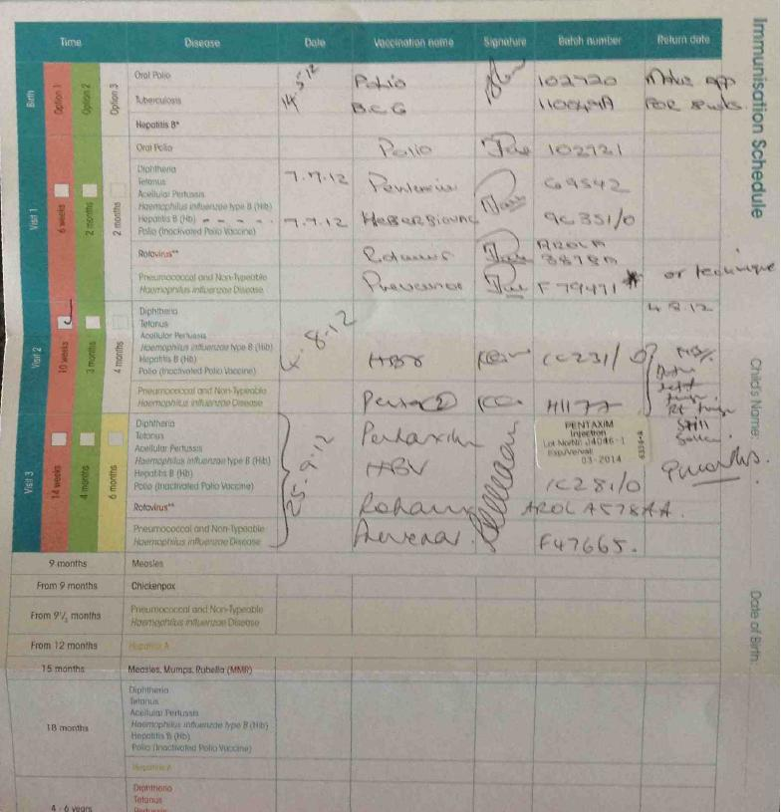
Issues related to vaccination cards
Card not matching the child: Wrong card for the child
Health facilities using old cards that don’t match current vaccination schedule
Damaged card– difficult to read
Bad handwriting
Card from different countries
Cards provided by private facilities
Replacement card with no dates indicated
Issues with the card

Slide 3
Issues related to vaccination cards, cont…

Slide 4
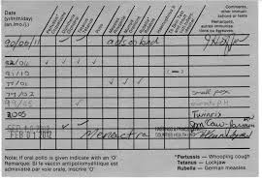
Issues related to vaccination cards, cont…
Issues with the card’s content
Vaccine given but no date
Incomplete date, incorrect date
Shows vaccine given but actually not
Confusion between date of next appointment vs. Date vaccination received.
Printing errors

Slide 5
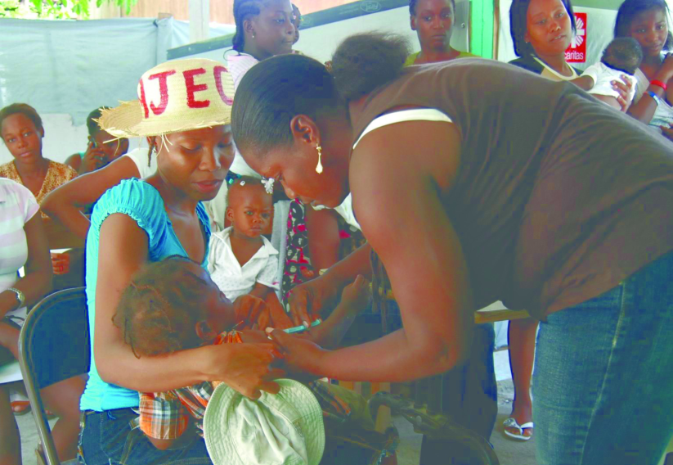
Issues related to mother’s reporting of vaccinations
The reliability of a history of vaccination elicited from the mother may vary with:
Health worker’s diligence in explaining what vaccinations have been given at each visit
The mother’s education
The recall period
The complexity of the vaccination schedule
The interviewer’s skills, attention to details, and use of appropriate language

Slide 6
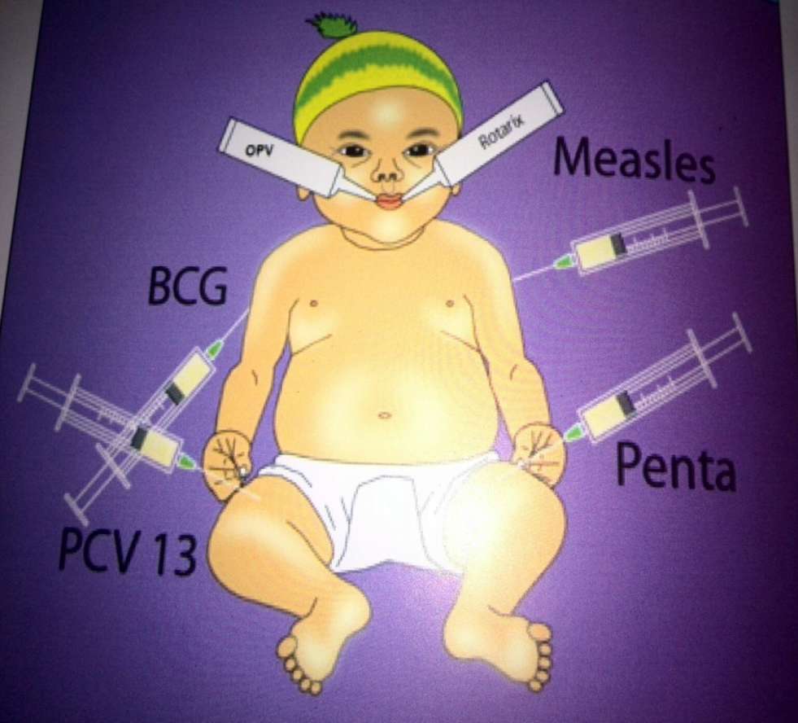
Differentiation
Polio vaccine and Rotavirus All are oral. Difference? One is two drops and the second is a liquid. Enough?
Confusion between Vit. A and Polio and Rotavirus?
Pentavalent and Pneumococcal All given on the thigh. Difference? Injection site Enough?
Mother may not have seen (or been present) when child received vaccine
Doses

Slide 7
