Slide 1
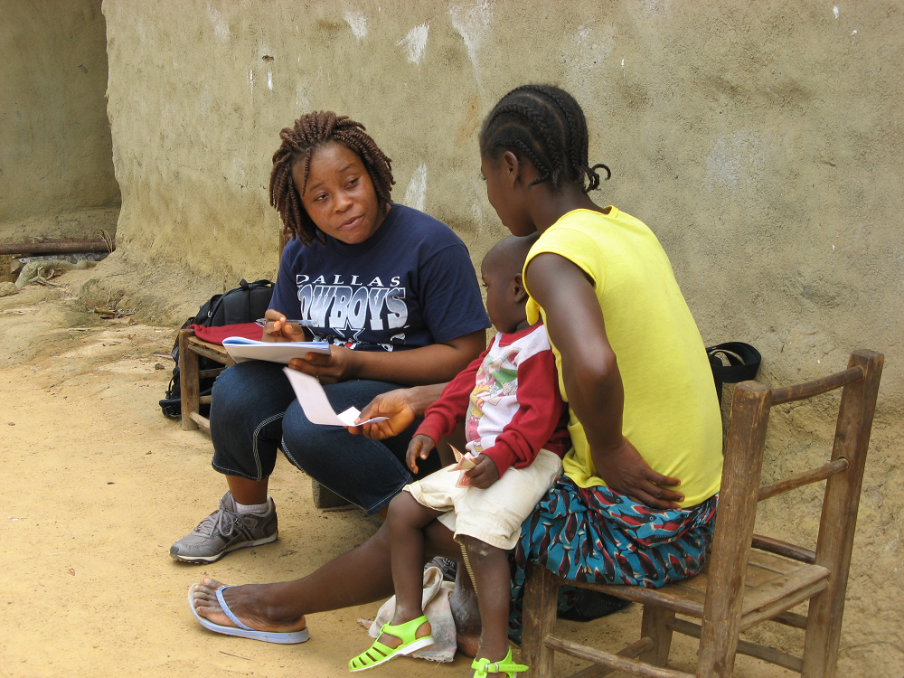
May I see (NAME)'s vaccination card?

Slide 2
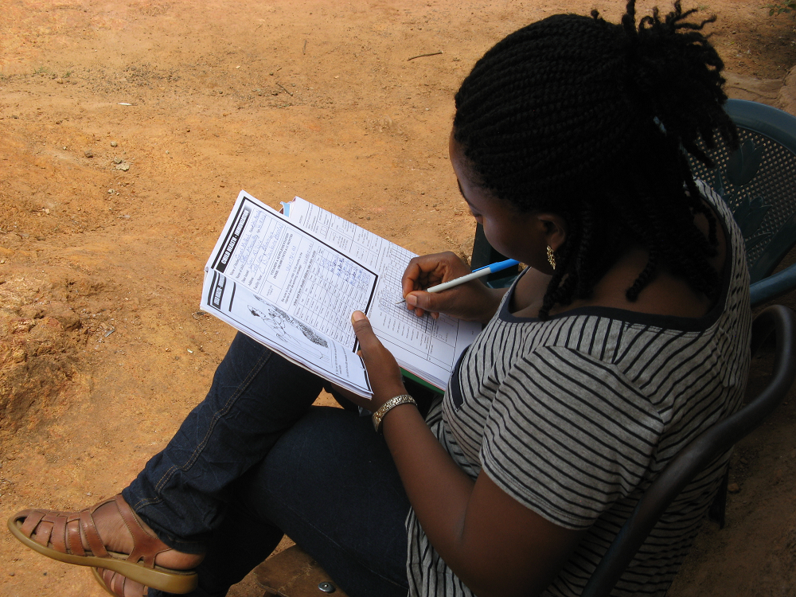
Outline
Training
Fieldwork
Example - Lesotho
Skit

Slide 3
Training
~3 week “pretest”
  10-20 participants
  2 weeks classroom training followed by ~1 week field practice
  ICF Survey Manager is present
~4 week “main training”
  ~100-200+ participants
  3+ weeks classroom training followed by several days of field practice
  ~ ¼ - ½ day of classroom training devoted to vaccinations
    EPI Manager or similar is involved in classroom training
  ICF Survey Manager is present
Tools
  Interviewer’s Manual, blank QREs, mock interviews
  Example vaccination cards/booklets
  Tests, quizzes

Slide 4
Fieldwork
Field team
  Supervisor, Field editor (paper QRE)
  ~4 Interviewers
  Health technician for biomarkers
Fieldwork
  Typically 3-6 months
Tools for monitoring quality
  Field editor (paper QRE); CAPI – built in checks
  Field supervision by central staff
  Field monitoring by ICF Survey Manager
  Field check tables by ICF Data Processor
  percentage of children with a vaccination card and percentage for whom card was seen.

Slide 5
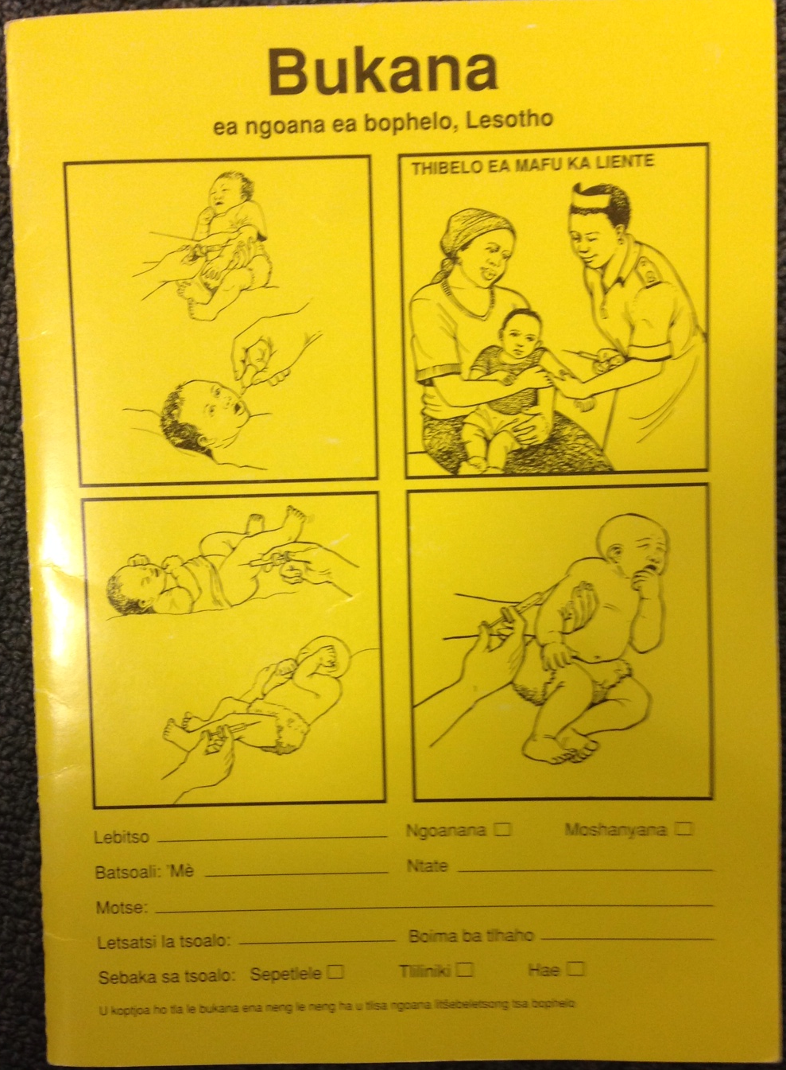
Example - Lesotho
EPI Schedule in Lesotho (2014)
1 dose of BCG vaccine (birth)
4 doses of OPV (birth dose, 6, 10, 14 weeks)
3 doses of DPT-HepB-Hib vaccine (6, 10, 14 weeks)
2 doses of measles vaccine (2nd at 18 months)
Also common to see vaccination booklets from RSA; RSA EPI schedule differs from Lesotho.

Slide 6
Section 5A: Child Immunization (Last Birth)
X
Mahlape
0 5
X

Slide 7
Recording Vaccinations from the Booklet
Order of vaccinations in QRE matches booklet.

Slide 8
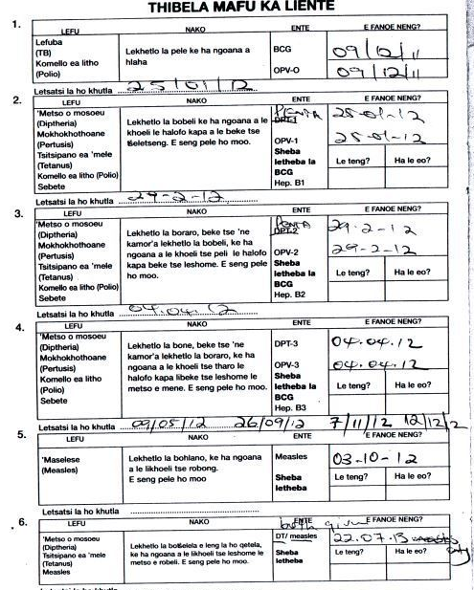
Recording Vaccinations from the Booklet

Slide 9
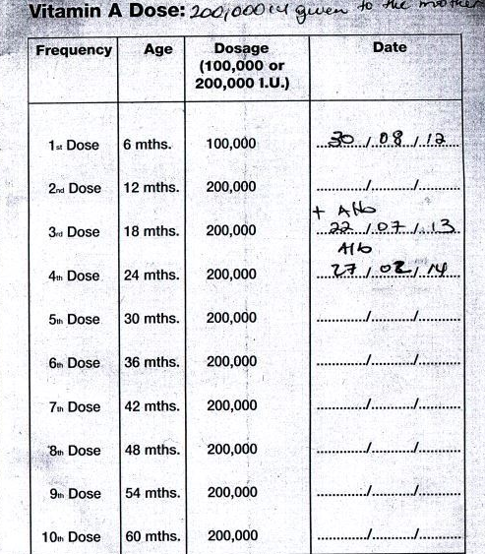
Recording Vitamin A from the Booklet

Slide 10
X

Slide 11
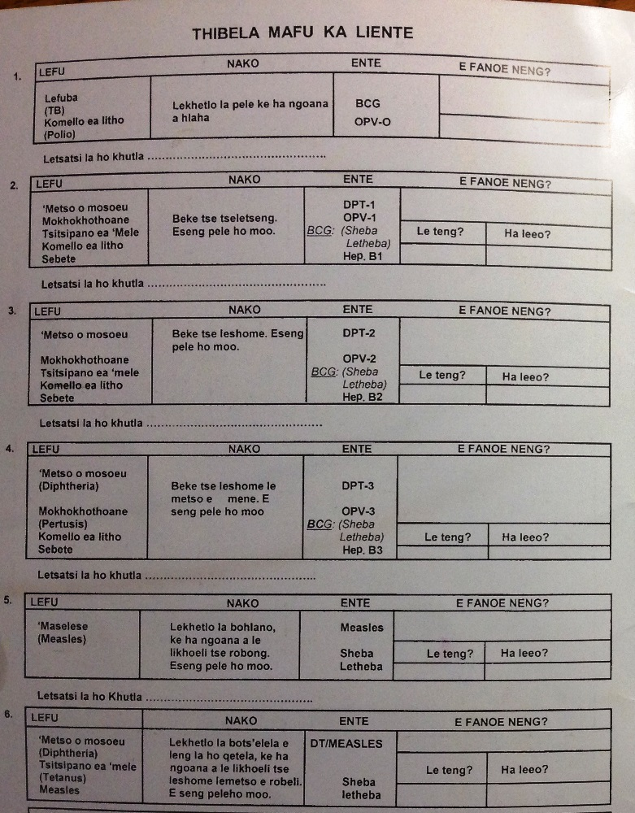
Box 1: Separate dates will be given for BCG and OPV-0. If OPV-0 is not given within 2 weeks, space next to OPV-0 in Box 1 will be blank.
Box 2-4: DPT-1, 2, 3 = penta 1, 2, 3 for the last ~6 years. Sometimes nurse will cancel “DPT” and replace it with word “penta” but not always. If you see DPT, interpret it as penta.
Date of next appointment is recorded here.

Slide 12
Box 2-4: Due to printing error, HepB1 appears below BCG in boxes 2-4. HepB1 is given as part of penta. Any date you see by HepB1 is a reference to presence of BCG scar and/or additional dose of BCG given because first did not take. Do not record this date.
Although nurses should record separate dates for both penta 1-3 series and OPV 1-3 series, they don’t always do so. If you see a single date in boxes 2-4, assume both vaccines were given. If you see a date by one vaccine and an O/S next to the other, the O/S means the vaccine was out of stock and was not given.

Slide 13
Section 5A: Child Immunization (Last Birth):
Mother’s Recall
X
Mahlape
0 5
X
X

Slide 14
Recording Vaccinations from Mother’s Recall
Mahlape
0 5
2
1

Slide 15
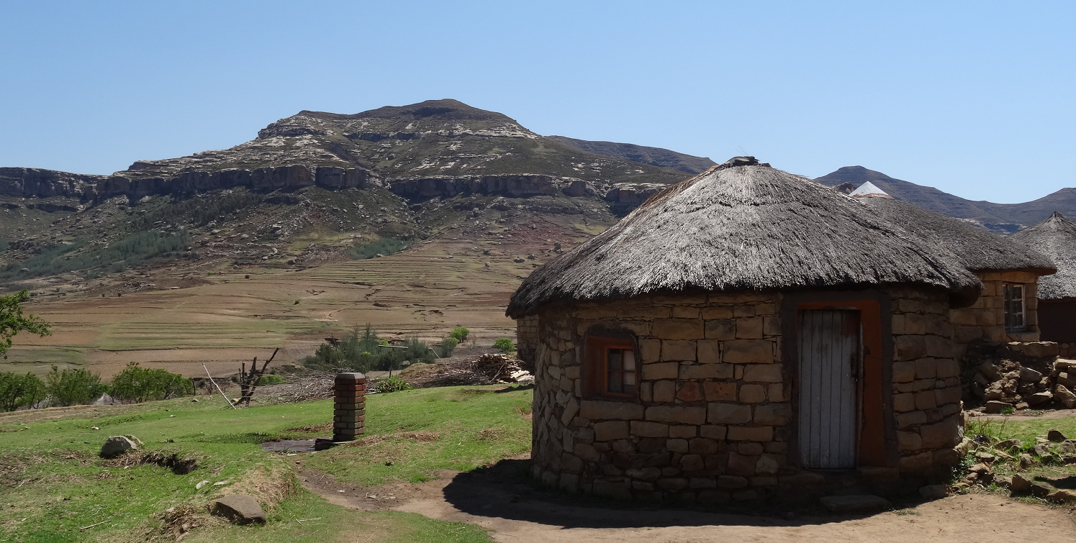
The Scene
Berea district
Me’ Mothabeng, an LDHS interviewer, is in the middle of an interview with Me’ Ramoseme, an LDHS respondent. The two women are sitting in the shade outside the Ramoseme rondoval. Me’ Ramoseme has had 3 live births, two of whom have been born since 2012.
  Thabo, male, age 11 months
  Palesa, female, age 2 years
The interviewer has reached Section 5A of the Woman’s QRE. Let’s listen in….

Slide 16
Please take out your questionnaires and follow along!

