Slide 1


Exploring issues of data quality in household surveys:
Searching for explanations behind discrepant results for vaccination coverage across surveys of different form
Technical Consultation on Vaccination Data in Household Surveys
23-24 July 2015
ICF International, Rockville, Maryland USA

Slide 2
Background
Population-based household surveys are a common source of information on infant immunization coverage data beyond administrative recording and monitoring systems
Three main household survey sources
  Expanded Programme on Immunization (EPI) cluster survey
  UNICEF-supported Multiple Indicators Cluster Survey (MICS)
  USAID-supported Demographic and Health Survey (DHS)
Within these surveys, vaccination history is determined by
  documented evidence within home-based records (HBRs)
  asking the child’s caregiver (recall) or
  through the combination of both sources
  some surveys may also include a facility trace back component wherein facility-based records are reviewed for documented evidence of vaccination history

Slide 3
Background
Some countries utilize the estimated coverage results from population-based household surveys when evaluating programme coverage levels, particularly if there are known problems with administrative coverage reports (e.g., systematic under-/over-reporting, missed sub-populations)
WHO and UNICEF utilize the estimated coverage results from population-based household surveys when producing estimates of national immunization coverage for each of 195 countries
Secretariat for Gavi, the Vaccine Alliance using coverage surveys as one of several data quality requirements in their grant monitoring framework

Slide 4
Across surveys, differences abound…
Primary objectives
Sampling schemes
Levels of oversight
Questionnaire format, content, verbal prompts for vax Hx, etc
Often, implementing agency differs
Data cleaning, analysis, reporting
Many other differences as one goes further into the operations and implementation
See Cutts et al, PLOS Medicine 2013

Slide 6
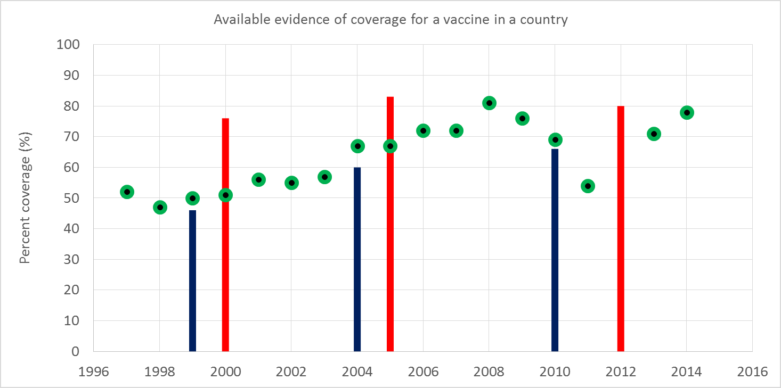
What is the most likely scenario ?
DHS/MICS
EPI CLUSTER
DHS/MICS
EPI CLUSTER
DHS/MICS
EPI CLUSTER

Slide 7
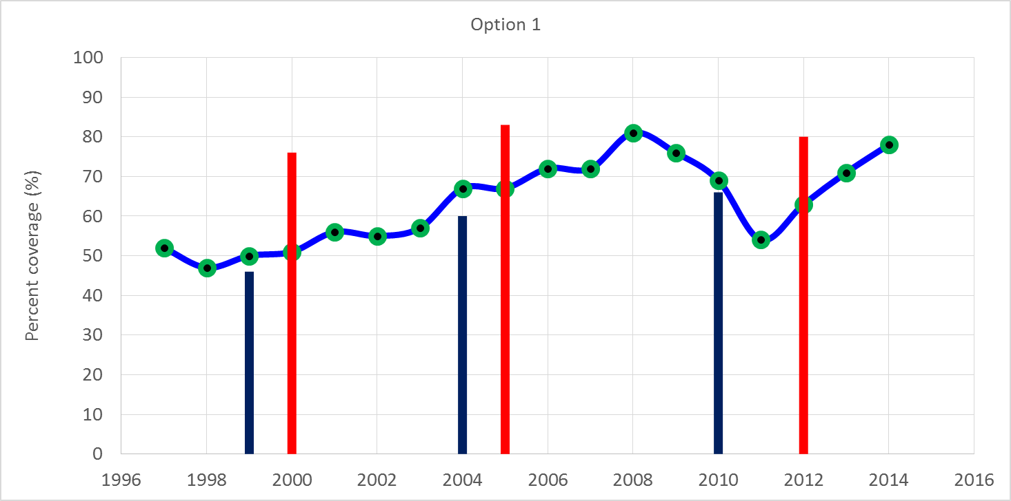
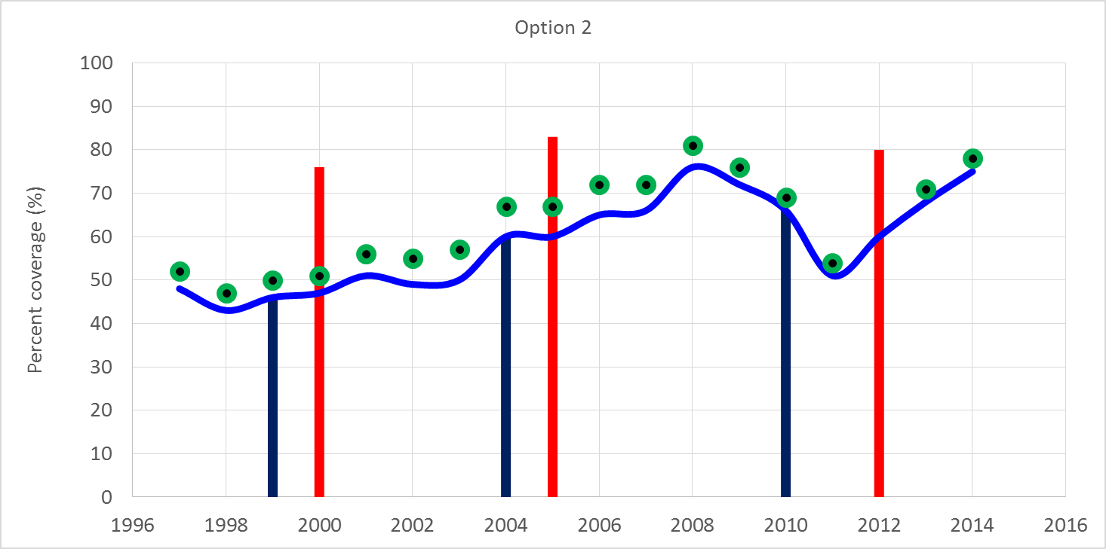
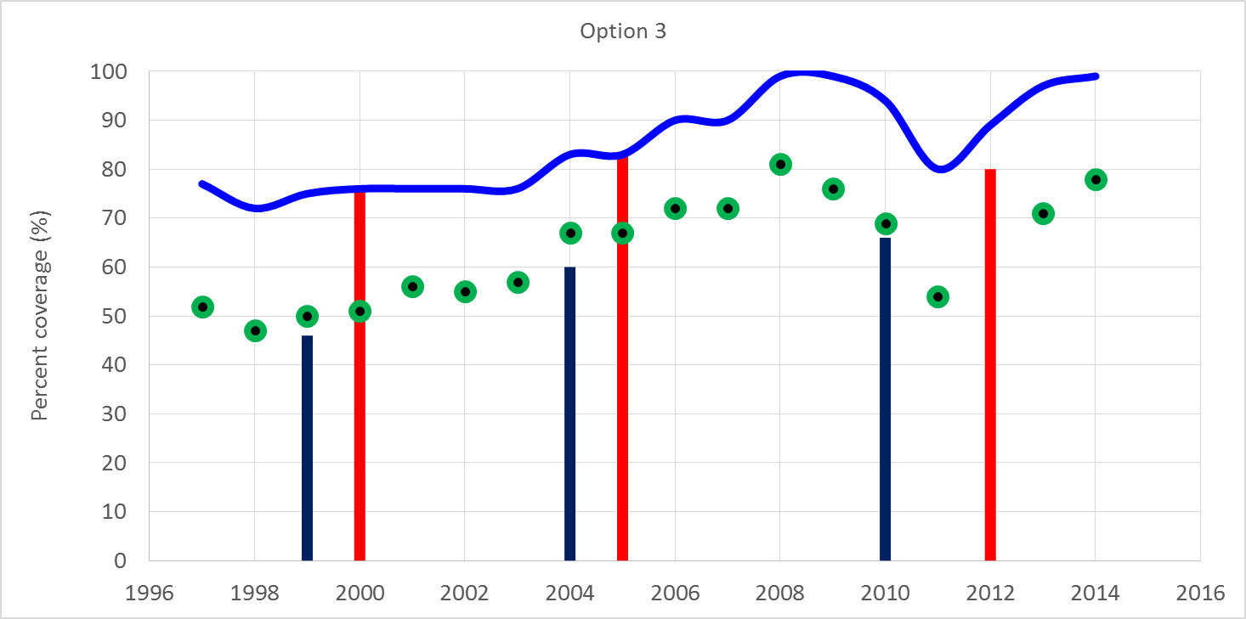
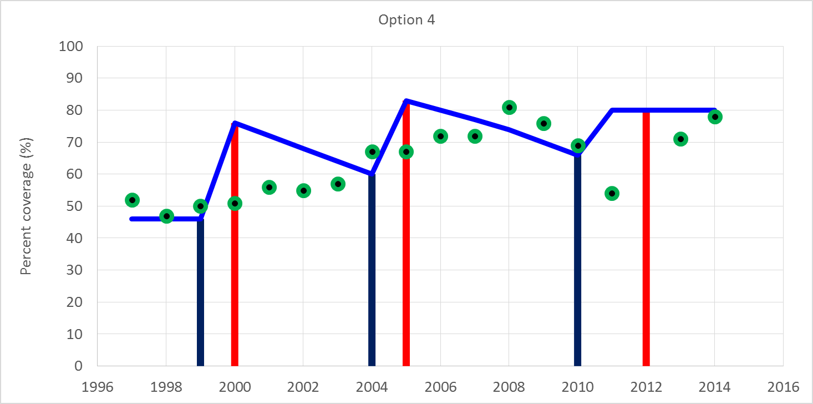

Slide 8
Observed differences across survey types
> documented evidence
median/mean home-based record ownership levels observed among children aged 12-23 months at the time of survey by survey type across 199 population-based, nationally representative surveys that estimated coverage for birth cohorts between 2005 and 2012
 | HBR, mean (s.e.) | HBR, median (IQR)
EPI | 74% (18.3) | 77% (25)
DHS/MICS | 62% (22.7) | 67% (38)
OCS | 56% (24.6) | 57% (37)
n=109
n=56
n=34

Slide 9
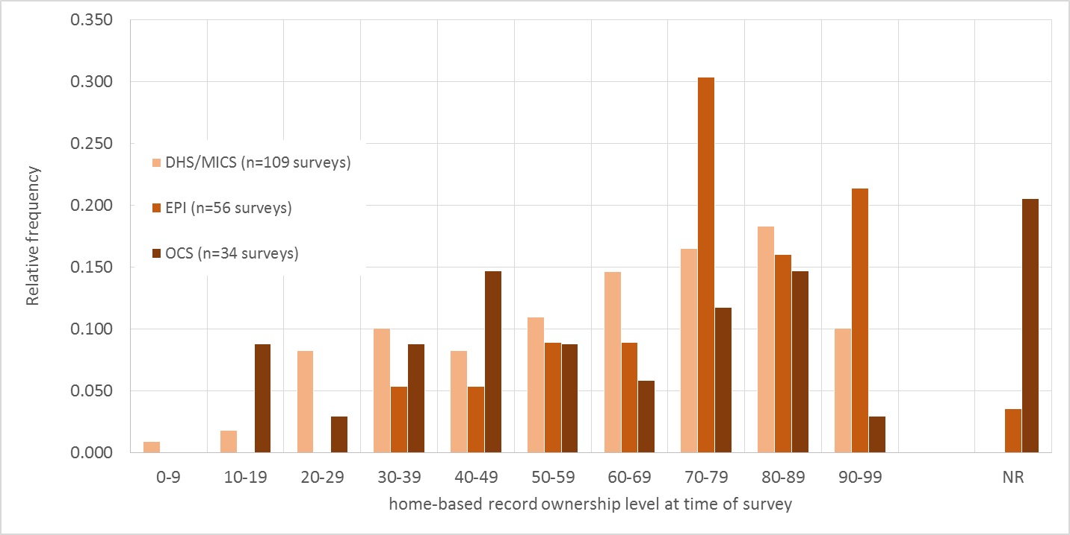
Observed differences across survey types
> documented evidence
Relative frequency of home-based record ownership levels observed among children aged 12-23 months at the time of survey by survey type across 199 population-based, nationally representative surveys that estimated coverage for birth cohorts between 2005 and 2012

Slide 10
Observed HBR ownership levels from above country example
Survey | Observed HBR ownership for children 12-23 m (%)
DHS, 1999 birth cohort | 27 (survey sample, n=2143 12-23 m old children)
2004 birth cohort | 37 (survey sample, n=1877 )
2010 birth cohort | 29 (survey sample, n=1927 )
EPI cluster, 2000 birth cohort | 52 (survey sample, n=3564 )
2005 birth cohort | 60 (survey sample, n=6903 )
2011 birth cohort | 37 (survey sample, n=3762 )

Slide 11
Reasons for observed differences in HBR ?
Perhaps related to…
Differences in sampling frame or field procedures in HH selection across survey types
Differences in survey field team training
Differences in implementation of time allowed for caregiver to fetch HBR
Others to be discussed…

Slide 12
THANK YOU

Slide 13
Additional example slides

Slide 14
Challenges
Scenario: 2 surveys estimating coverage for the same birth cohort
  EPI cluster survey with sample of 3000+ children aged 12-23 m and observed HBR prevalence of 83% estimates
    DTCV3 (HBR+recall)=85%
    Pol3 (HBR+recall)=85%
  DHS with sample of 935 children aged 12-23 m and observed HBR prevalence of 75% estimates
    DTPCV3 (HBR+recall)=75% ; adjusted for recall bias=80%
    Pol3 (HBR+recall)=42%
  Both estimates for polio cannot be correct.

Slide 15
Challenges
Scenario: 2 surveys estimating coverage for the same birth cohort
  EPI cluster survey with sample of 3000+ children aged 12-23 m and observed HBR prevalence of 80%, estimates
    DTCV3 (HBR+recall)=70%
    Pol3 (HBR+recall)=68%
  DHS with sample of 1200 children aged 12-23 m and observed HBR prevalence of 60%, estimates
    DTPCV3 (HBR+recall)=72%
    Pol3 (HBR+recall)=90%
  Again, both estimates for polio cannot be correct, but in this case it is likely that the estimated level from the DHS reflects doses given during campaigns given frequent polio SIAs in the country and reliance on recall for 40%
  Challenge—mechanisms for isolating routine vs SIA vaccination

Slide 16
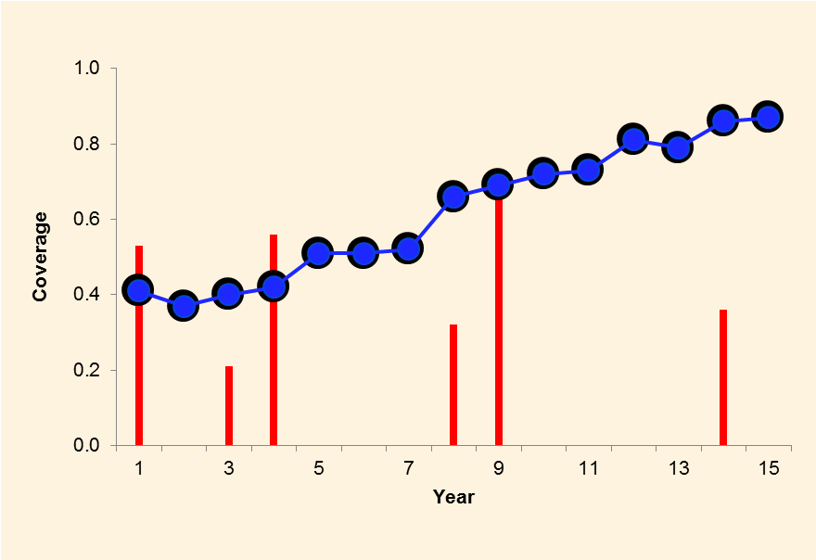
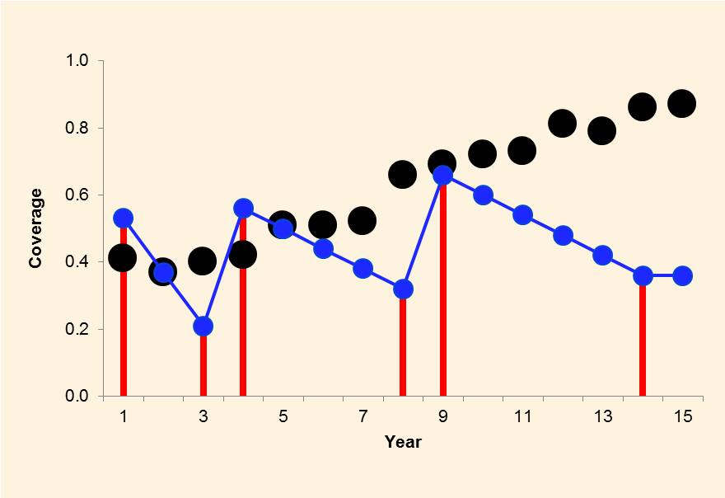
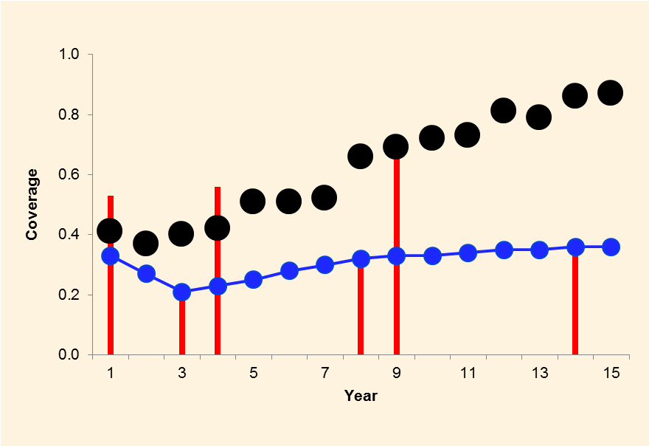
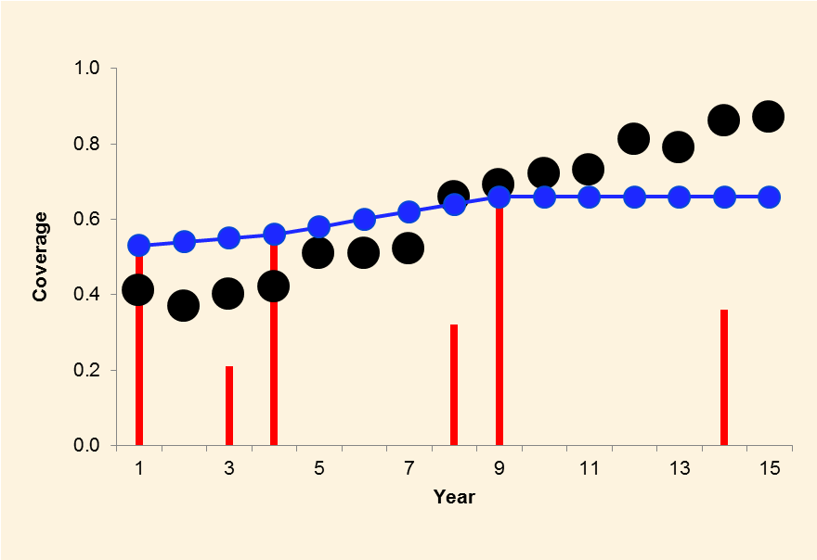
I: ignore surveys
II: all surveys
III: household surveys
IV: national EPI surveys

Slide 17
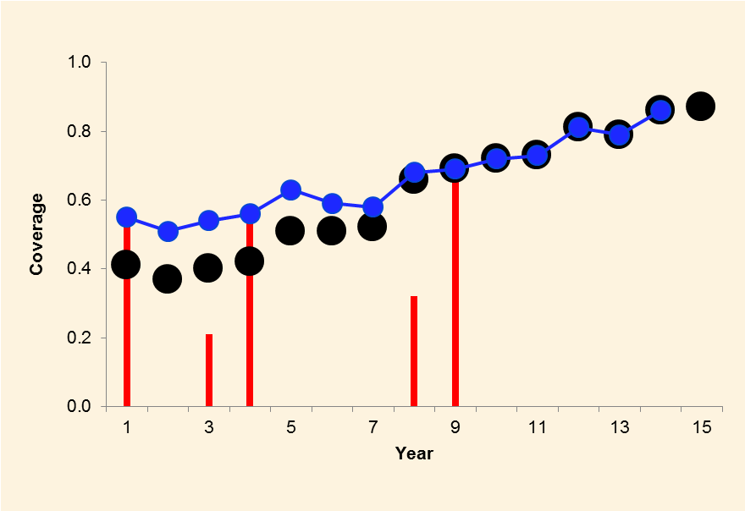
What we did previous year.

Slide 18
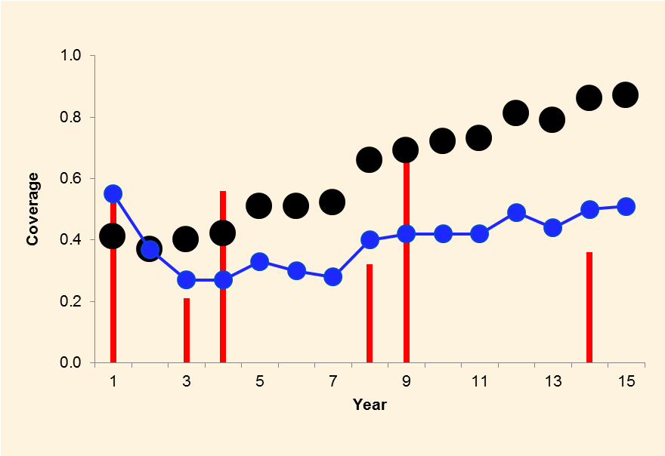
Influence of new data.

