Slide 1
DHS, MICS, and EPI Surveys: An Overview of Information Captured

Slide 2
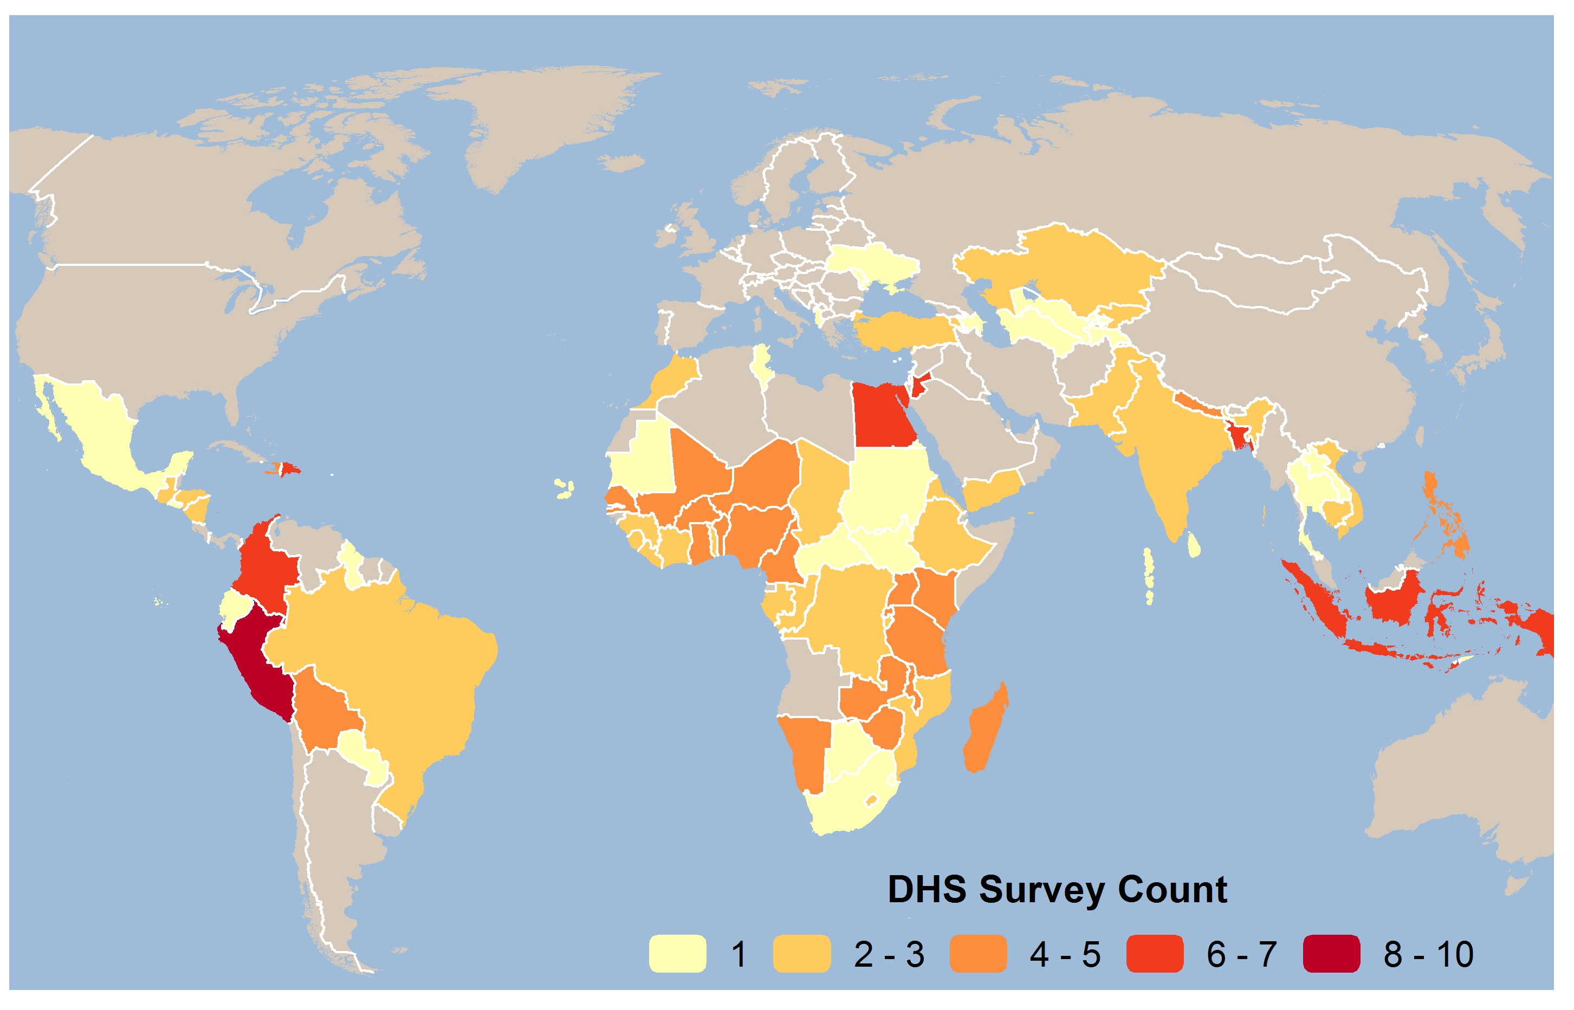
Since 1984, DHS has provided technical assistance in over 90 countries for the implementation of more than 300 surveys
Notes:
This is a map of all countries that have conducted a DHS. DHS is a worldwide program. Nearly all DHS collect info on vaccinations. And lots of countries have carried out multiple DHS, theoretically, making trend analysis possible (although as we’ll undoubtedly discuss, this is not so straightforward given that vaccination schedules are changing over time). A map of countries that have conducted MICS would look similar to this one.

Slide 3
Commonalities between DHS and MICS
Multi-topic surveys
Close harmonization
  indicator definitions
  questions and wording
  methodologies
Flexible research instruments
  modules to meet country requirements
Multi-stage cluster sampling
  ~5000-100,000 households
  Designed to produce national, urban/rural, and regional estimates
Indicators generally calculated in the same way

Slide 4
DHS and MICS Questionnaires
DHS Model QREs
MICS Model QREs
Household
Women (15-49)*
Men (15-49/54/59)
Biomarkers (anthropometry, anemia, and HIV)
Many optional modules
*Children under age 5 questions in woman’s questionnaire
Household
Women (15-49)
Men (15-49)
Children under age 5*
Form – Vaccination Records at Health facility
*Anthropometry in child’s questionnaire

Slide 5
Type and Location of Questions on Vaccinations
DHS Model QREs
MICS Model QREs
In Woman’s Questionnaire
Routine vaccinations/ campaigns
  Children age 0-2 born to interviewed women
    Excludes foster/orphans
Tetanus toxoid injections
  Women age 15-49 with a live birth in the past 5 years
In Child’s Questionnaire
Routine vaccinations/ campaigns
  Children age 0-2 in household
    Includes foster/orphans
Health Facility Form
In Woman’s Questionnaire
Tetanus toxoid injections
    - Women age 15-49 with a live birth past 2 years

Slide 6
Child Vaccination Sections of DHS and MICS Questionnaires
Collect data from:
  Vaccination or health cards/booklets or other document (if available)
  Mother’s report of vaccinations given (if no card)
  Health facilities (MICS – Optional)
Antigens included
  All that are standard in the vaccination schedule for children 0-2.
  Antigens received in campaigns/immunization days/child health days

Slide 7
Questionnaire design
Questionnaire design process is similar in each program
  Questionnaires start from model questionnaires
  Adapted to the needs of the country through questionnaire design meetings with stakeholders
  Translation into local language(s)
  Back translation

Slide 8
Woman’s QRE: Child immunization section (DHS7)
Notes:
One child at a time. Four pages per child.

Slide 9
Woman’s QRE: Child immunization section (DHS7)

Slide 10
Child’s QRE: immunization module (MICS5)

Slide 11
Child’s QRE: immunization module (MICS5)

Slide 12
QRE Form – Vaccination Records at Health facility (MICS5)

Slide 13
Vaccines in model DHS and MICS questionnaires
Vaccine/Antigen | DHS | MICS
BCG | X | X
Hep B (birth dose) | X | X
OPV (birth dose) | X | X
OPV 1-3 | X | X
DPT-Hep B-Hib 1-3 | X
DPT 1-3 |  | X
Hep B 1-3 |  | X
Hib 1-3 |  | X
Pneumococcal 1-3 | X
Rotavirus 1-3 | X
Measles Containing Vaccine | X (2 doses) | X (1 dose)
Yellow fever (1 dose) |  | X
Footnotes within Model QREs provide guidance on how QREs should be modified depending on vaccination schedule.

Slide 14
EPI Cluster Surveys/Vaccination Coverage Cluster Surveys*
Single topic survey
  Routine/Campaign immunizations for children 12-23 months
  Reasons not vaccinated
  Women’s TT.
Simpler sample design
Quicker
Less expensive
Dirtier(?)
*In process of being updated

Slide 15
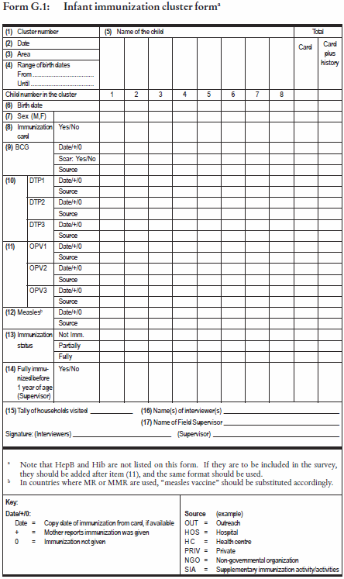
EPI model cluster survey form
Multiple children per form; children from same cluster not same household.
1 dose of BCG
3 doses of OPV
3 doses of DPT
1 dose of measles
Form doesn’t include questions, e.g. how to describe each vaccine.
Form does collect information on source of vaccination.

