Slide 1

The changing vaccination landscape and the sources of vaccination data
Technical Consultation on Vaccination Data in Household Surveys
23-24 July 2015, ICF International, Rockville, Maryland USA
Marta Gacic Dobo, WHO

Slide 2
Routine Immunization schedule, 1977
7 antigens , 3 visits during first year of life
BCG, 3 doses of DTP, and Polio, 1 dose of Measles and Smallpox

Slide 3
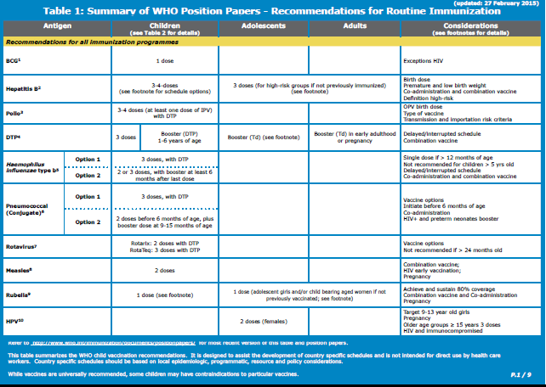
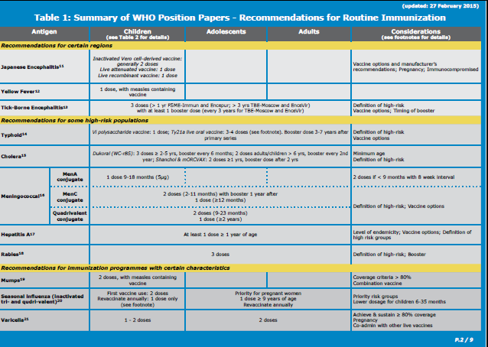
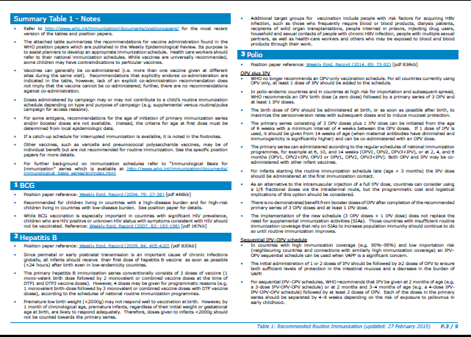
Routine Immunization schedule, 2015
WHO recommends 12 antigens for all immunisation programmes
Vaccines for certain regions ex. Yellow Fever, Japanese Encephalitis
Vaccines for high risk populations ex. Cholera, Typhoid
http://www.who.int/immunization/policy/immunization_tables/en/

Slide 4

Number of Vaccines/Antigens Introduced Nationwide in Immunization Schedules - 2000 compared to date
Selected antigens are :
Diphtheria, Tetanus, Pertussis, Measles, Polio - universal use
Hepatitis B,
Heamophilius Influenza type B,
Pneumococcal conjugate
Rotavirus
Rubella
2000
5 antigens (DTP, Measles and Polio)
6 antigens
7 antigens
July 2015
8 antigens
9 antigens
10 antigens
Not applicable
Not available
Data Source: WHO/IVB Database, as at 20 July 2015
Map production: Immunization Vaccines and Biologicals, (IVB), World Health Organization
Date of slide: 20 July 2015
The boundaries and names shown and the designations used on this map do not imply the expression of any opinion whatsoever on the part of the World Health Organization concerning the legal status of any country, territory, city or area or of its authorities, or concerning the delimitation of its frontiers or boundaries. Dotted lines on maps represent approximate border lines for which there may not yet be full agreement.
© WHO 2015. All rights reserved
Notes:
Brazil

Slide 5
Vaccine introduction status over time (1990 to date)
40 Introduction in 33 countries in 2015
Data Source: WHO/IVB Database, as at 20 July 2015
Date of slide: 20 July 2015

Slide 6
Vaccine introduction status over time
(1990 to date) in low and middle income countries
Data Source: WHO/IVB Database, as at 20 July 2015
Date of slide: 20 July 2015

Slide 7
99 countries introducing IPV between
July 2015 and March 2016
Grenada – Indonesia – Mauritius – Nauru and Yemen are introducing in 2015 but no month of introduction available.
Source: WHO/UNICEF database as at 01 June 2015

Slide 8
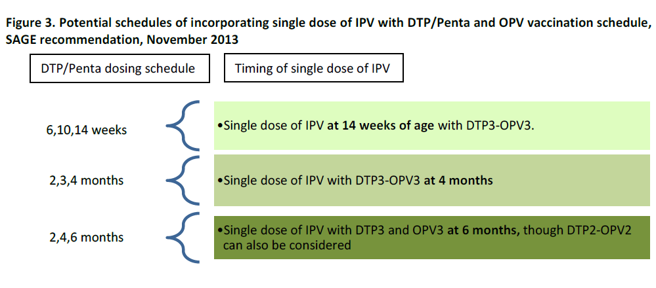
Proposed IPV schedule
Some countries mainly in American region will use sequential schedule
replacing 1st dose of OPV with IPV

Slide 9
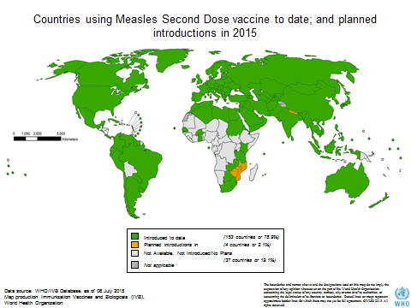
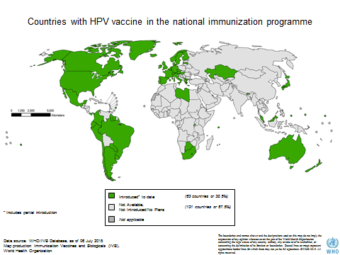
Immunization across life span
Measles 2nd dose
  2nd year of life / School age
HPV
  Adolescent girls

Slide 10
Countries with Influenza vaccine in the national immunization program
Introduced* to date
(103 countries or 53%)
Introduced* in parts of the country
(2 countries or 1%)
* Includes partial introduction
Not Available, Not Introduced/No Plans
Not applicable
(89 countries or 46%)
Data source: WHO/IVB Database, as of 06 July 2015
Map production Immunization Vaccines and Biologicals (IVB),
World Health Organization
The boundaries and names shown and the designations used on this map do not imply the expression of any opinion whatsoever on the part of the World Health Organization concerning the legal status of any country, territory, city or area or of its authorities, or concerning the delimitation of its frontiers or boundaries. Dotted lines on maps represent approximate border lines for which there may not yet be full agreement. ©WHO 2015. All rights reserved.
Notes:
Introduced* to date
Algeria Andorra Antigua and Barbuda Argentina Australia Austria Bahamas (the) Bahrain Barbados Belarus Belgium Belize Bolivia (Plurinational State of) Brazil Brunei Darussalam Bulgaria Canada Chile China Colombia Cook Islands Costa Rica Cuba Cyprus Czech Republic (the) Denmark Dominica Dominican Republic (the) Ecuador Egypt El Salvador Estonia Finland France Georgia Germany Grenada Guatemala Honduras Hungary Iceland Iran (Islamic Republic of) Iraq Ireland Israel Italy Jamaica Japan Jordan Kazakhstan Kuwait Lao People’s Democratic Republic (the) Latvia Libya Luxembourg Malaysia Malta Marshall Islands (the) Mauritius Mexico Micronesia (Federated States of) Monaco Mongolia Montenegro Morocco Nauru Nepal Netherlands (the) New Zealand Nicaragua Niue Norway Oman Palau Panama Paraguay Peru Philippines (the) Portugal Qatar Republic of Korea (the) Republic of Moldova (the) Romania Russian Federation (the) Saint Lucia Saudi Arabia Serbia Slovakia Slovenia South Africa Spain Suriname Switzerland Thailand Trinidad and Tobago Tunisia Turkey Turkmenistan United Arab Emirates (the) United Kingdom of Great Britain and Northern Ireland (the) United States of America (the) Uruguay Venezuela (Bolivarian Republic of)
Partial introduction: Maldives and Sweden

Slide 11
Challenges
Number of visits same, number of interventions changed over time
  Combination vaccines (DTP => DTP-HepB-Hib)
  Additional vaccines at same visit (PcV, Rota ...)
  Additional dose (measles 2nd dose)
Recording and reporting more and more complex
Frequent changes in schedule => changes in home based records, facility based records
  Delays in updates
Availability of home based records (in some countries very low)
Mothers recall?

Slide 12
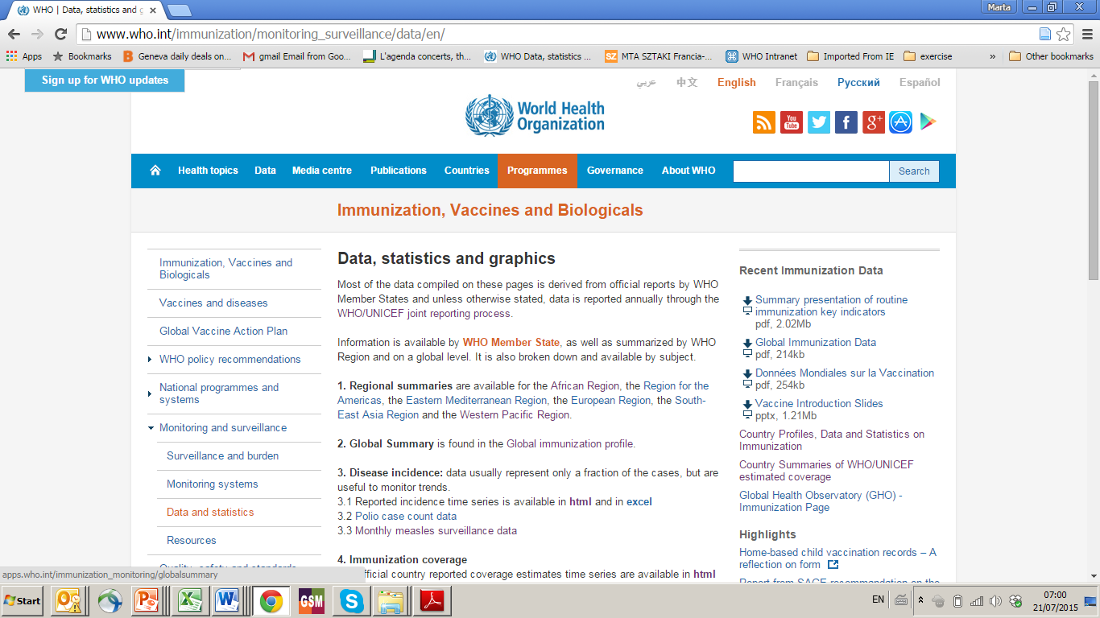
Useful links http://www.who.int/immunization/monitoring_surveillance/data/en/
6. Immunization schedule. Data are available for:
6.1 Reported immunization schedules by vaccine in html and in excel
6.2 Year of introduction of selected vaccines database in excel
6.3 Immunization schedules by disease covered by antigens within age range in html
6.4 Immunization provided at school in excel

Slide 13
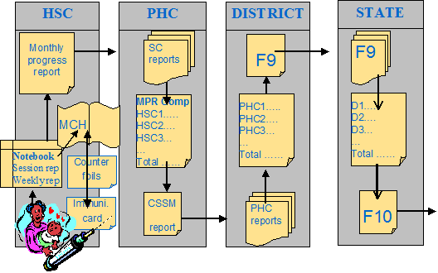
Administrative coverage flow of reporting

Slide 14

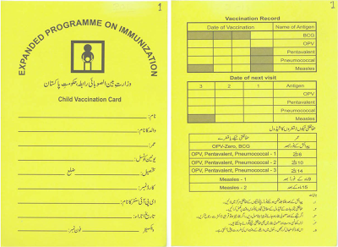
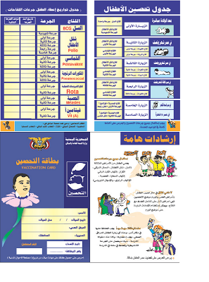
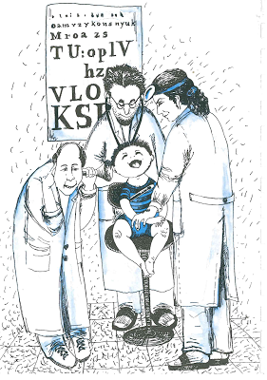
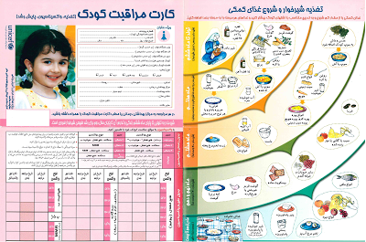
Home based vaccination records
- big diversity -
Vaccination card
Vaccination card plus
Child health booklet
Changes over time
Different cards by regions or public / private sector in country
http://www.immunizationcards.org/

Slide 15
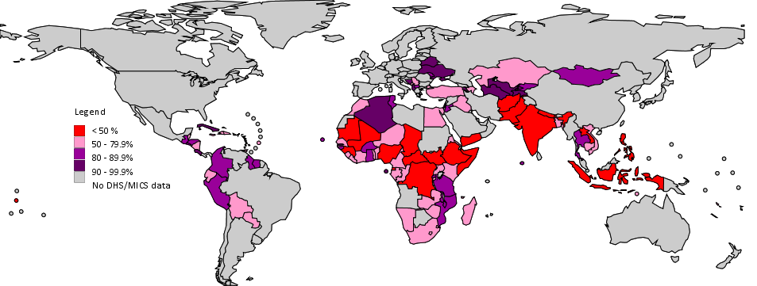
Prevalence of HBR
Latest national estimated prevalence of HBR based on DHS and MICS surveys (2000-2013) as of 30 April 2014

Slide 16
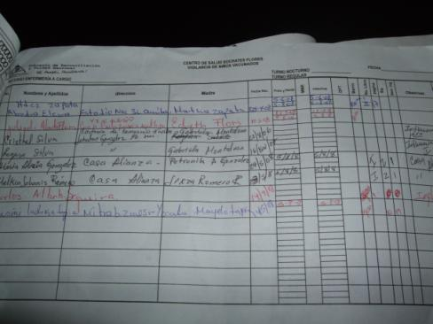
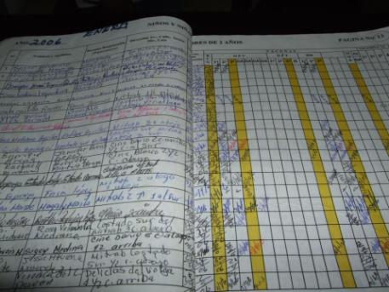
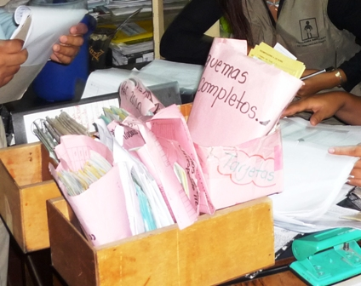
Facility based registries
Non standardised registries
Different recording practices
Mostly paper based systems

Slide 17
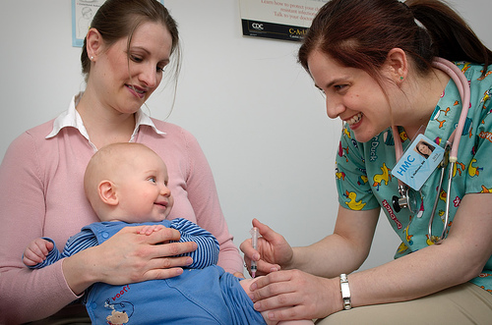
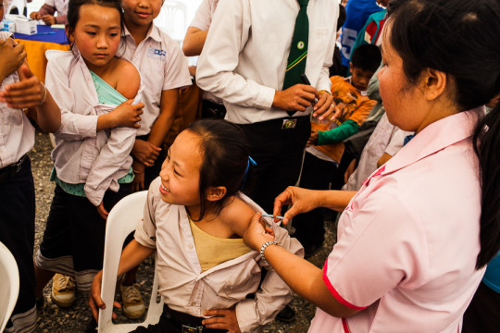
Delivery strategy
Part of routine services
Vaccination campaigns
  Fixed post
  Outreach
  Private sector

Slide 18
Summary
In most countries at least 1 antigen was added to immunization schedule in past 3-5 years
Most likely recording tools have changed
  Home based records
  Facility based records and registries
Delays in changing recording tools might have occurred
In most countries it was at least one supplementary campaign in past 3-5 years (measles / polio / meningitis .... )
Increasing importance of 2nd year of life (Measles vaccination, booster doses)

Slide 19
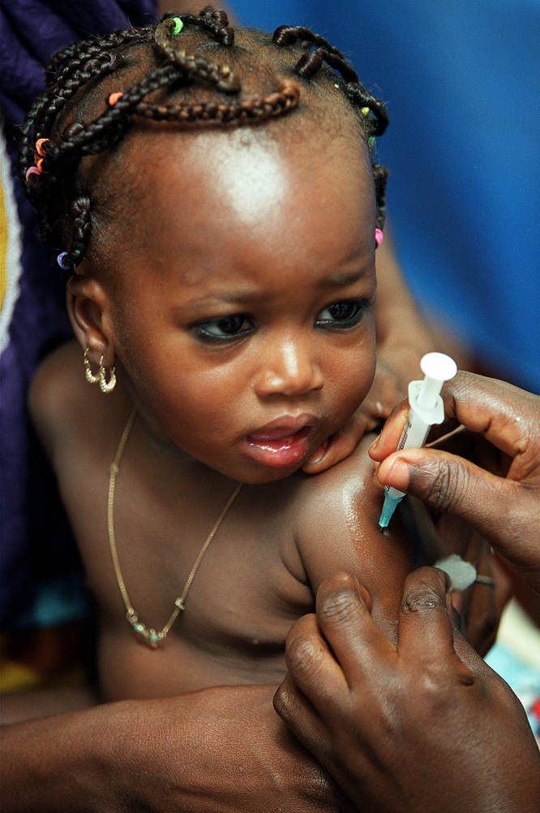
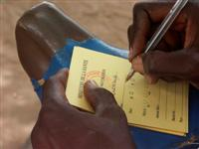
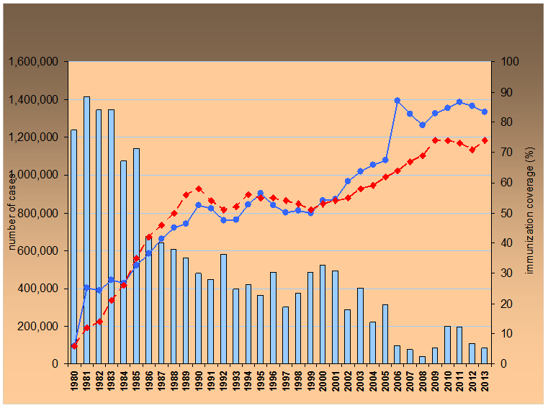
Thank You

Slide 20
Advantages and disadvantages of administrative and survey methods
Administrative method
Advantages:
  Based on data necessary for service provision
  Timely management monitoring tool
  Provides data at local level
Disadvantage / Limitations :
  Denominator (target population may be projected based on old census data)
  Transcription or calculation errors
  Incomplete reporting
  May Include vaccination conducted outside the target group.
  May not include private sector
Survey method
Advantages:
  Estimate of immunization coverage can be obtained if the denominator is unknown.
  Provides additional information on social economical status of reached and unreached children
  Vaccinations given by the private sector reflected
Disadvantage / Limitations:
  Provides information on the previous birth year’s cohort.
  Immunization card availability
  Reliance on recall in absence of card
  Interviewer interaction
  Length or complexity of the questionnaire may compromise accuracy
  Representativeness of sample
Notes:
World Health Organization
27 July 2015
20
Font size

