Slide 1
Reporting on Vaccination Coverage
Technical Consultation on Vaccination Data in Household Surveys
July 23-24, 2015
Trevor Croft, ICF International

Slide 2
Vaccination table (Malawi DHS 2010)

Slide 3
Calculations
Line 1:
Percentage of ALL children 12-23 receiving vaccine according to card.
Line 2:
Percentage of ALL children 12-23 receiving vaccine according to mother’s recall.
Line 3:
Percentage of ALL children 12-23 receiving vaccine according to either source.
Line 3 = Line 1 + Line 2.
Note that denominator for all 3 lines is from the third line.
Line 4:
Percentage of ALL children 12-23 receiving vaccine before age 12 months.
Only available for those with vaccine cards
Estimated for mother’s report, based on data for those with cards

Slide 4
Vaccination table (Bangladesh DHS 2011)
…

Slide 5
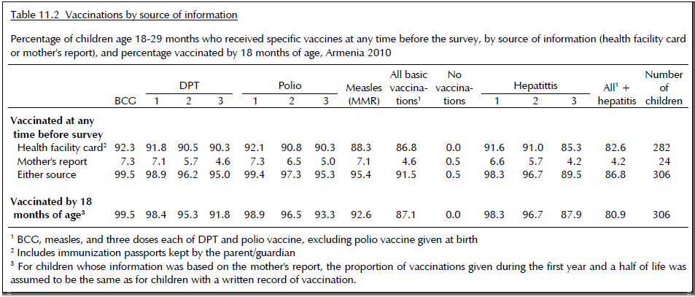
Vaccination table (Armenia DHS 2010)

Slide 6
Issues
Different vaccine combinations
Age cohorts and target groups
Full vaccination & basic vaccination
Evidence of home based record (HBR)
Timely doses and valid doses
HPV

Slide 7
Vaccine combinations
Differing vaccine schedules may apply in the three years preceding the survey
Pentavalent v. DPT, HepB, Hib separately.
Need to capture both those recorded as Pentavalent and those recorded as separate vaccines
Proposal:
Present data on antigens separately if collected separately
If only given as Pentavalent, present as DPT-HepB-Hib combined

Slide 8
Age cohorts and age appropriate vaccination
Standard cohort: children 12-23 months of age
For MCV given at 12-15 months, DHS & MICS have used 15-26 or 18-29
Other vaccines also have older target groups
MCV2 at 18-21 months
Rubella at 12 months
WHO/UNICEF recommendation
Use single year cohorts, e.g. 12-23, 24-35, 36-47 months
Present data for those cohorts for appropriate vaccines

Slide 9
Fully vaccinated & basic vaccination
Fully vaccinated
All vaccines given according to schedule as appropriate for age
Should some vaccines be excluded? (e.g. Polio 0)
Should newer vaccines be excluded for a period of time until fully established?
Otherwise trends may decline when new vaccines are introduced
Cases when vaccines should not be given?
Basic vaccination
BCG, Polio 1-3, DPT 1-3, Measles only
Argued that this is useful for monitoring trends
Excludes newer vaccines, including Polio 0 (at birth)
Is this concept useful?

Slide 10
Evidence of home based record
Include evidence of home based record in tabulations:
Ever had vaccination card
Currently has vaccination card
Vaccination card seen by interviewer
Do we need all 3?

Slide 11
Timely doses
Given by 12 months of age
Calculated by applying the proportion of vaccines given before age 12 months of those with sufficient date information*, to the total proportion of children receiving a vaccine:
$$\frac{Vaccinated}{Number of children}∗\frac{Vaccinated by 12 months}{Vaccinations with sufficient date info}$$
DHS 1-6: calculated to the month
DHS 7: now possible to the day.
Apply to appropriate age for vaccine
e.g. 24 months for MCV2
Relies on good date of birth and vaccination dates

Slide 12
Valid doses
Given with appropriate spacing
e.g. 4 weeks between Polio 1 & 2.
Hep.B at birth within < 24 hours?
Relies on good date information for each vaccine
Data quality can be a big issue
Not currently presented in DHS tabulations
Probably more appropriate for secondary analysis

Slide 13
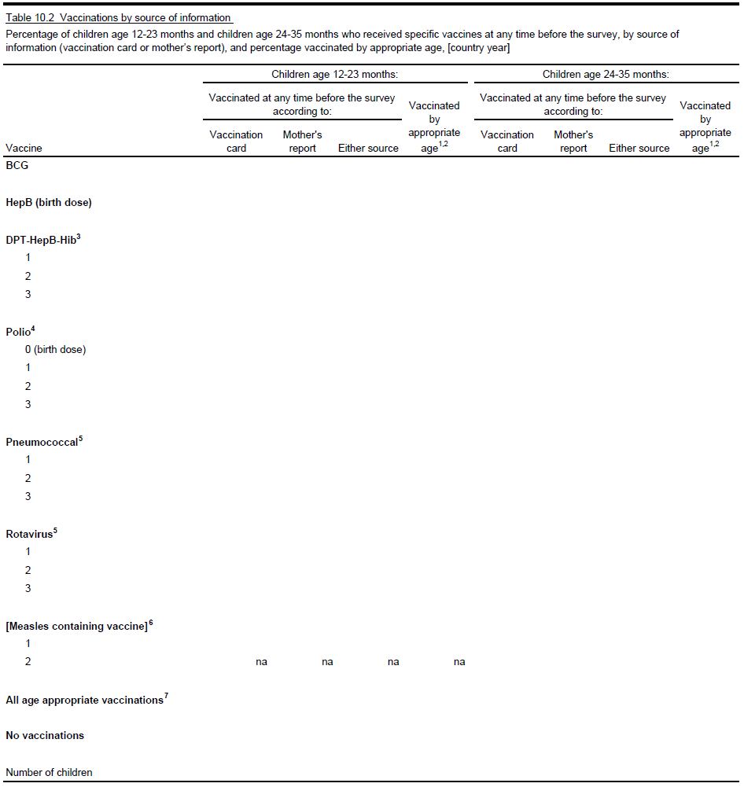

Slide 14
HPV
If we are to include HPV, what is needed for reporting?
Women receiving HPV 1, 2, 3?
Received by age 15? 13?
Similar reporting to, say, DPT?

